Slide 1

Foundations of Individual Behavior

Slide 2

Organizational Behaviour
The multidisciplinary field that seeks knowledge of behavior in organizational settings by systematically studying individual, group, and organizational processes,
for the purpose of apply such knowledge for organizational effectiveness

Slide 3
Foundations of Individual Behavior
Organizations are complex systems
Human behavior in organization is unpredictable
Human behavior in organization can be partially understood
There is no perfect solution to organizational problems

Slide 4
Good Reasons Why You Should Care About the individual Behavior
Understanding the dynamics of behavior in organizations is essential to achieving personal success as a manager, regardless of your area of specialization
Principles of organizational behavior are involved in making people both productive and happy on their jobs
To achieve success in today’s rapidly changing environment, organizations must successfully address a wide variety of OB issues
Making People Both Productive and Happy On Their Jobs
Changing Environment, Organizations work practices due technological transformation

Slide 5
Individual Behavioue

Slide 6
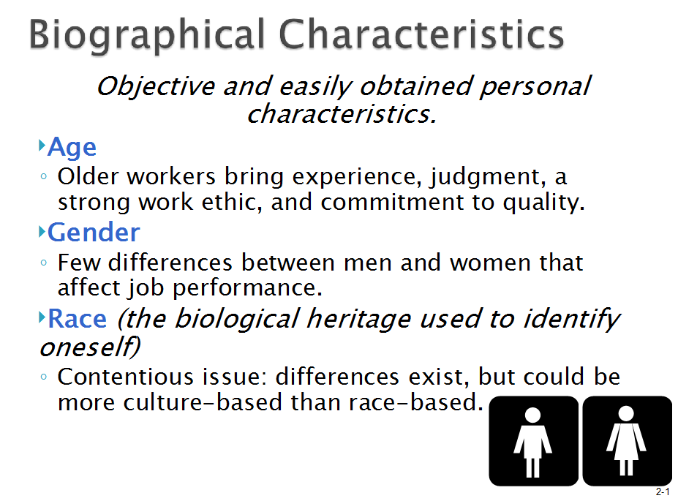
Biographical Characteristics

Slide 7
Personal factors
Age: It has impact on performance, turnover,
absenteeism, productivity, and satisfaction
Gender: also has an impact on turnover and absenteeism
Education: Increased levels of education serve to increase an individual's expectations about positive outcomes.
Ability It refers to an individual's capacity to perform various tasks in a job. The ability of an individual is made up of two sets of skills-intellectual and physical

Slide 8
Personal factors
Marital status This has an influence on absenteeism, turnover, and satisfaction.
Number of dependents There is correlation between the number of dependents an employee has and his or her absences and satisfaction
Creativity This is yet another important factor that influences individual behaviour

Slide 9
Factors Influcing individual behavior
Personal Factor
Environmental factor
Psychological factors
Organizational factors

Slide 10
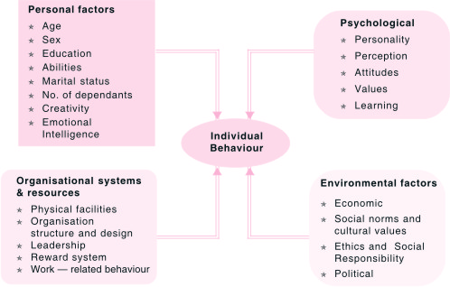
Foundations of Individual Behaviour
OB, Source : K Aswathappa

Slide 11
Foundations of Individual Behavior
OB recognizes that each individual are ‘unique’ and ‘different’
The behavior of individual / employees is
Situation dependent
Trait dependent
Acquired –Habit dependent

Slide 12
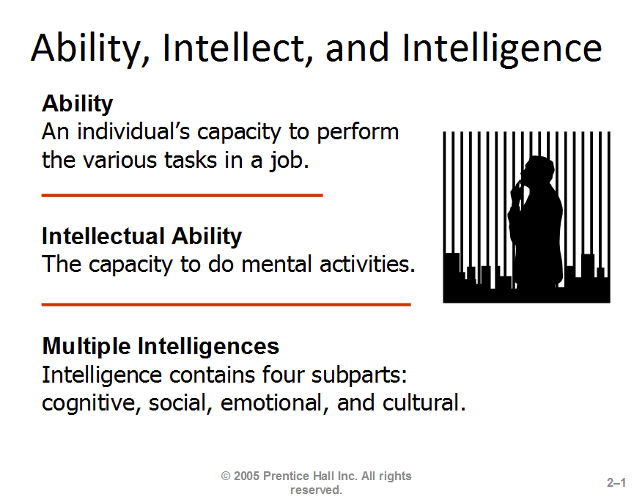
1.
2.
3.

Slide 13
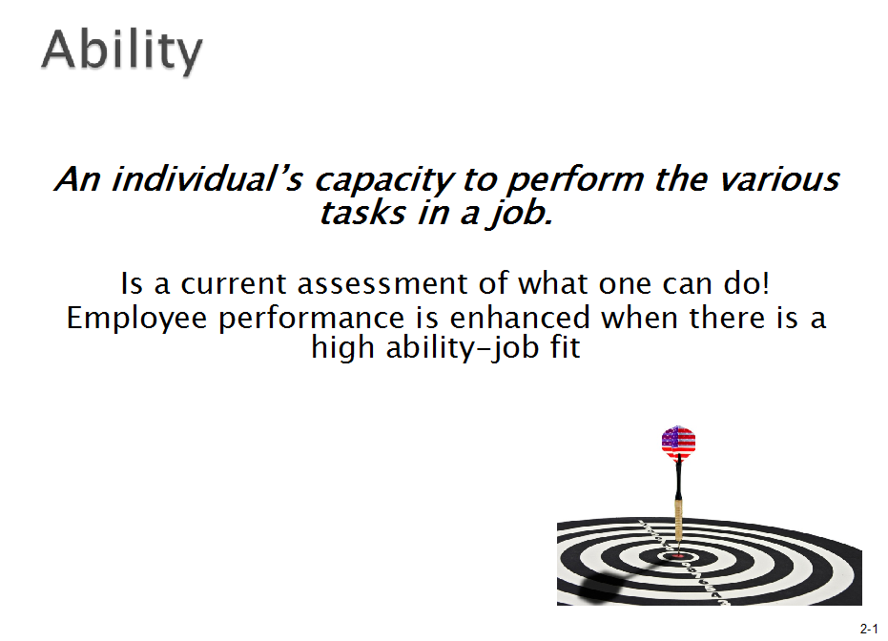

Slide 14
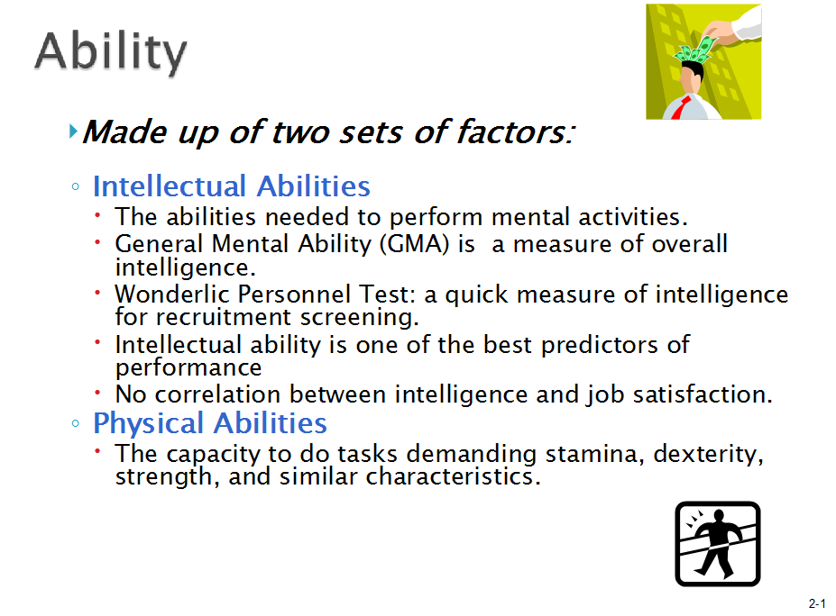
1.
2.

Slide 15
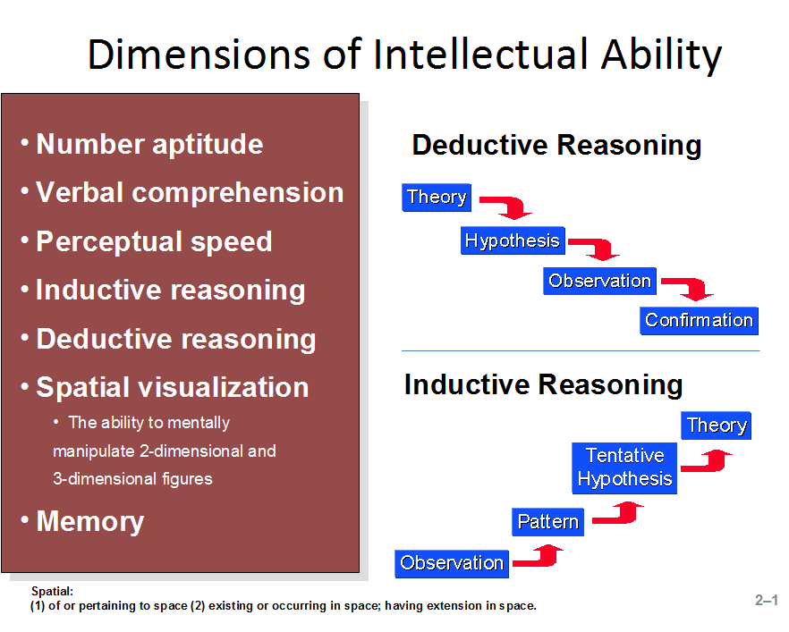
© Copyright Prentice-Hall 2004

Slide 16
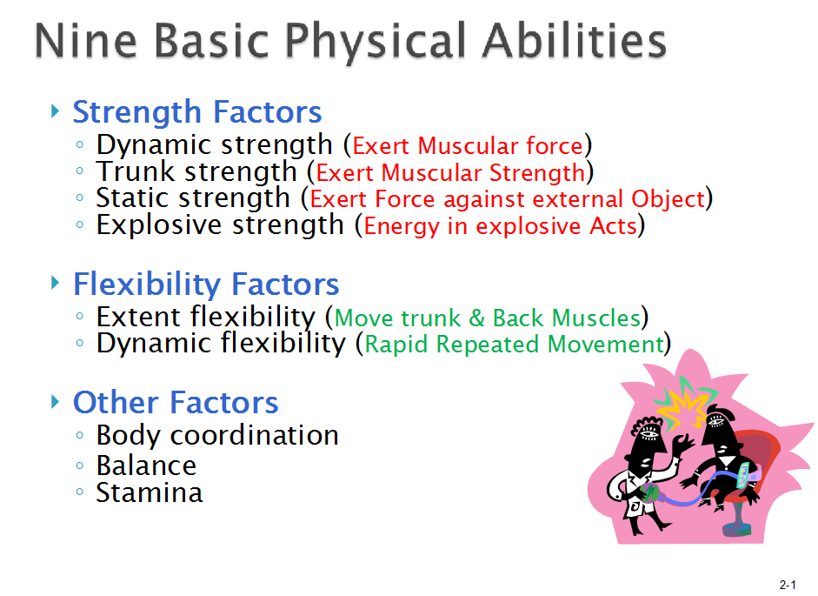

Slide 17
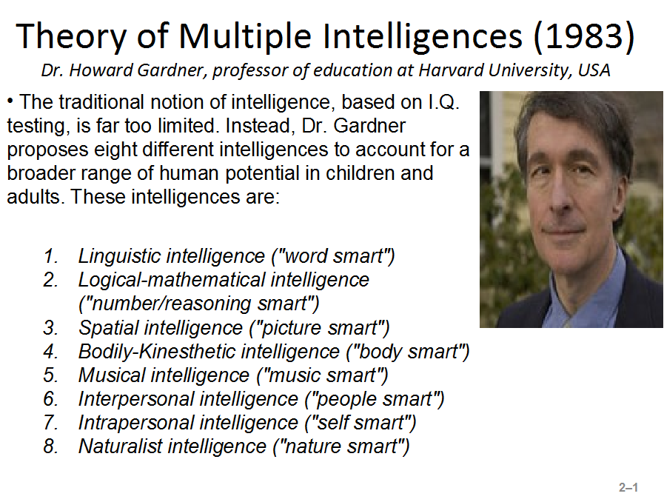

Slide 18
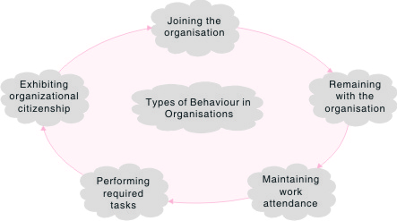
Stages/ types in Organizational Life

Slide 19
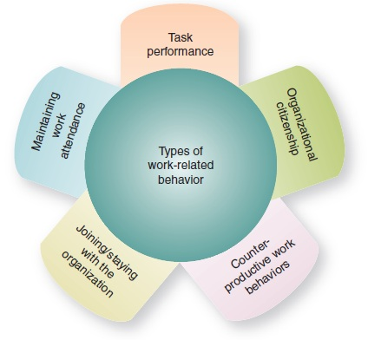
Types of individual behaviour
https://www.managementstudyguide.com/types-of-employee-behaviour.html

Slide 20
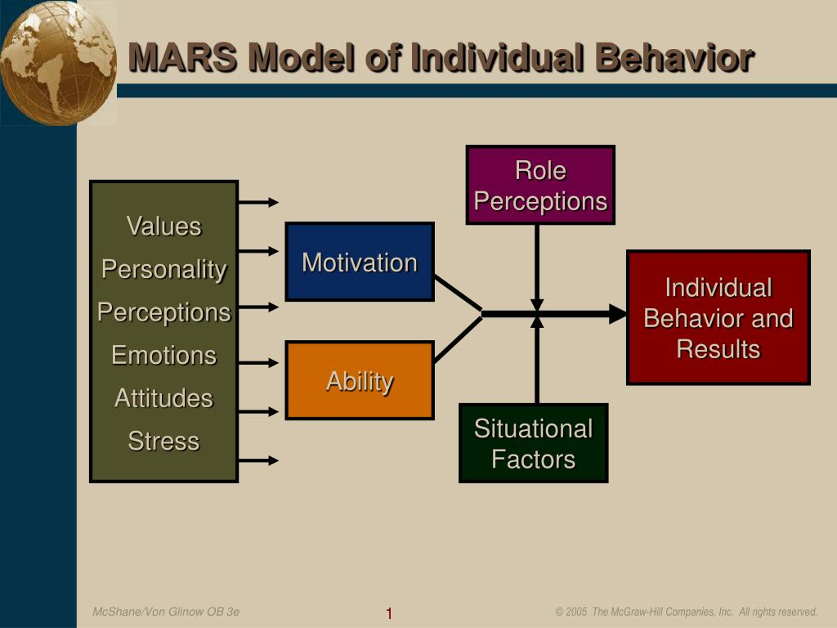

Slide 21
Models of Individual Behaviour
Rational Economic Man-economic incentives. and economic gain.
Social Man-motivated by social needs
Organizational Man- individual utmost importance to organisational interest
The Self Actuating Man- man is self motivated
Complex man presents the real picture of human picture of human behavior. All the previous models make very simplistic assumptions about people and their behaviour.

Slide 22
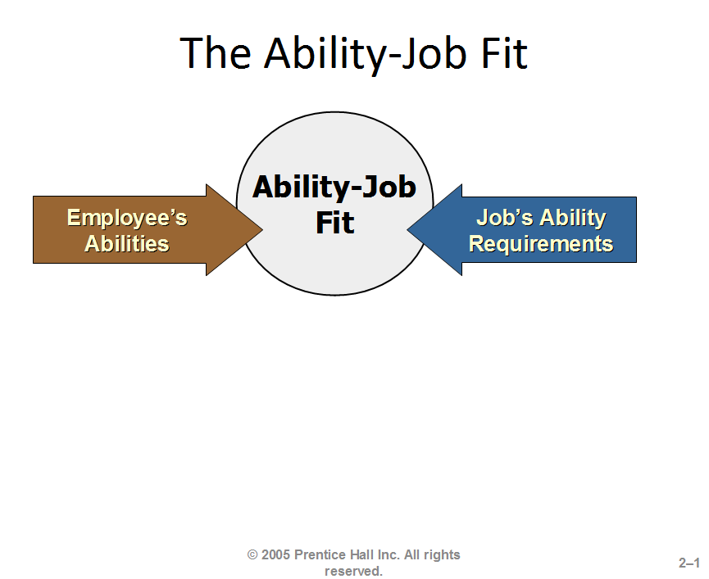

Slide 23
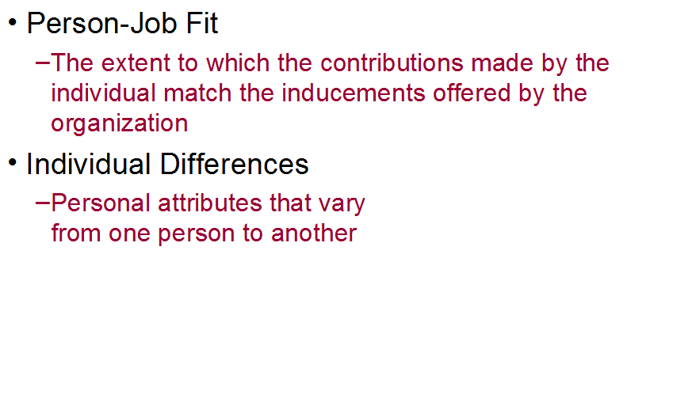

Ability – Job Fit :Ability-Job Fit It is widely known that employees differ in their physical and intellectual abilities and the jobs they perform demand varied abilities. Employee performance is enhanced where there is high ability-job fit.

Slide 24
People in Organizations
Psychological Contract
A person’s overall set of expectations regarding what he or she will contribute to the organization and what the organization, in return will provide to the individual
Individuals contribute effort, skills, ability, time, loyalty
Organizations provide inducements in the forms of tangible / intangible rewards

Slide 25
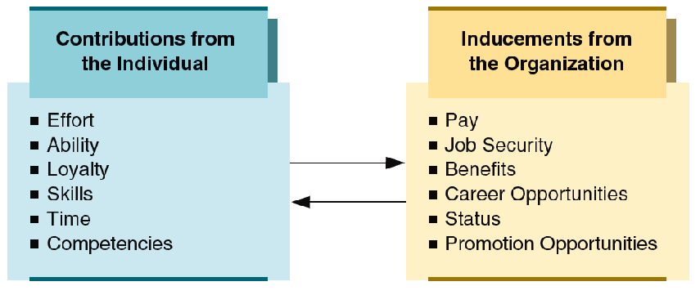
Psychological contract

Slide 26
Thank You

